Slide 1
ANALYSIS OF COSTS
MGCR 293
Dr. K. Salmasi
Dr. Taweewan Sidthidet
Dr. Tariq Nizami
T.A.: Mike Brintnell
Presentation Credit: Brianna Mooney

Slide 2
Agenda
Lecture Review:
Economic Costs
Short-Run vs. Long Run
Average and Marginal Costs
Economies of Scale
Economies of Scope
Breakeven Analysis
Chapter Questions

Slide 3
CHAPTER REVIEW

Slide 4
ECONOMIC COST AND OPPORTUNITY COST
Economic Cost is the sum of explicit accounting costs plus implicit costs (ie: opportunity costs). Economic costs are always greater than or equal to accounting costs
Opportunity Cost is the value of the next best alternative forgone. The opportunity cost of an input is the value that could have been generated from using that input in the best alternative way to the way it is being used now.
Sunk Costs are resources that are spent and cannot be recovered; these costs should be ignored and managers should focus only on future costs and benefits

Slide 5
SHORT-RUN VS. LONG-RUN COSTS
The Cost function relates input costs and output
In the short run:
there are fixed costs that are incurred (ie: have to be paid) no matter what output is produced
there are variable costs that are incurred depending on the quantity being produced
$$Short Run Total Cost=Total Fixed Cost+Total Variable Cost$$

Slide 6
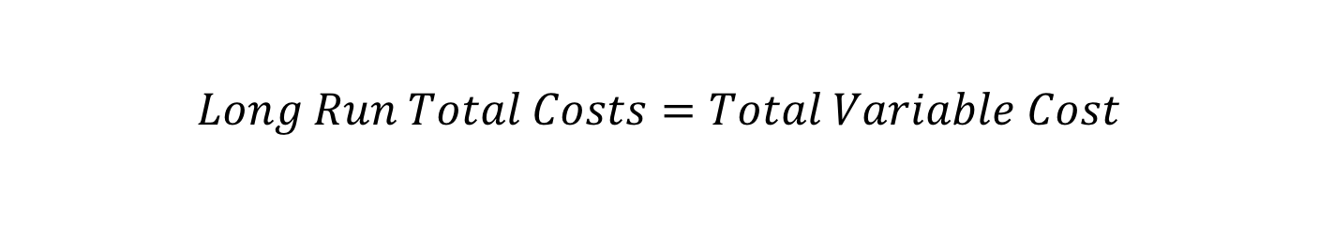
SHORT-RUN VS. LONG-RUN COSTS
In the long-run, all costs are variable (ie: there are no fixed costs)
One has the time to shift resources, change inputs and/or acquire more capital, plants or land
$$Long Run Total Costs=Total Variable Cost$$

Slide 7
FIXED, VARIABLE AND TOTAL COSTS
Output | Total Fixed Cost (TFC) | Total Variable Cost (TVC) | Total Cost (TC) | Average Fixed Cost (AFC) | Average Variable Cost (AVC) | Average Total Cost (ATC) | Marginal Cost (MC)
0 | 100 | 0 | 100 | - | - | - | -
1 | 100 | 40 | 140 | 100 | 40 | 140 | 40
2 | 100 | 64 | 164 | 50 | 32 | 82 | 24
3 | 100 | 78 | 178 | 33.33 | 26 | 59.33 | 14
4 | 100 | 88 | 188 | 25 | 22 | 47 | 10
5 | 100 | 100 | 200 | 20 | 20 | 40 | 12

Slide 8
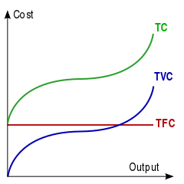
TOTAL COST, TOTAL VARIABLE COST AND TOTAL FIXED COST
Total cost and total variable cost differ only by the fixed cost, and thus have the same shape of curve, except total cost is greater (or shifted up graphically) by the amount of the fixed cost

Slide 9
AVERAGE AND MARGINAL COSTS
Average fixed cost decreases over time, as a fixed number is being divided by a growing quantity of output
This is known as spreading overhead, where the fixed costs are being distributed over a growing number of units of production

Slide 10
AVERAGE AND MARGINAL COSTS
Average variable cost is minimized when it equals marginal cost
If marginal cost is less than average variable cost, average variable cost is decreasing
If marginal cost is greater than average variable cost, average variable cost is increasing
Marginal cost intersects average total cost (ATC) at its minimum as well, however this intersection will be at a greater output level than the level of output that minimizes average variable cost (AVC). ATC is minimized at higher output than AVC because the decrease in AFC more than offsets the increase in AVC as output increases for a certain amount of time

Slide 11
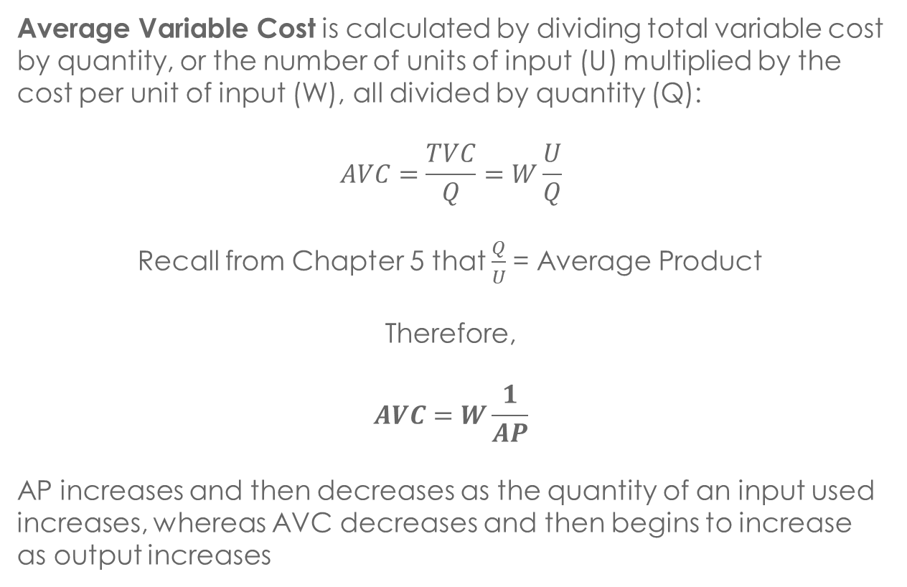
AVERAGE VARIABLE COST
Average Variable Cost is calculated by dividing total variable cost by quantity, or the number of units of input (U) multiplied by the cost per unit of input (W), all divided by quantity (Q):
$$AVC=\frac{TVC}{Q}=W\frac{U}{Q}$$
Recall from Chapter 5 that $\frac{Q}{U}$= Average Product
Therefore,
$$AVC=W\frac{1}{AP}$$
AP increases and then decreases as the quantity of an input used increases, whereas AVC decreases and then begins to increase as output increases

Slide 12
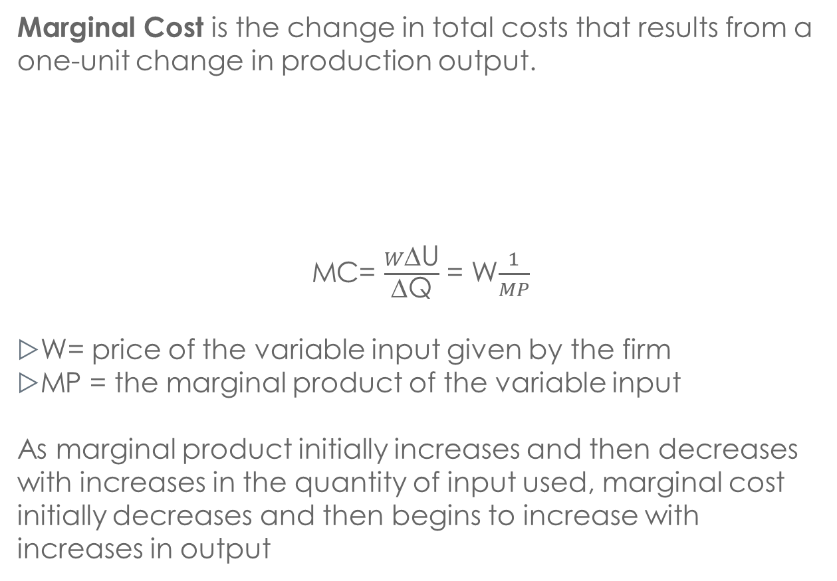
MARGINAL COST
Marginal Cost is the change in total costs that results from a one-unit change in production output.
MC= $\frac{W\text{Δ}\text{U}}{\text{Δ}\text{Q}}$ = W$\frac{1}{MP}$
W= price of the variable input given by the firm
MP = the marginal product of the variable input
As marginal product initially increases and then decreases with increases in the quantity of input used, marginal cost initially decreases and then begins to increase with increases in output

Slide 13
LONG RUN AVERAGE COST FUNCTION
A combination of all short-run average cost curves at their minimum point
Any point on the long run average cost function is also the minimum point on the short run average cost function

Slide 14
ECONOMIES OF SCALE
Economies of scale exist when the firm’s average unit costs decrease as input increases
When LRAC is decreasing, the firm is realizing economies of scale
When LRAC is minimized (and equal to long run marginal cost), the firm has constant returns to scale
When LRAC is increasing, the firm is realizing diseconomies of scale

Slide 15
ECONOMIES OF SCALE

Slide 16
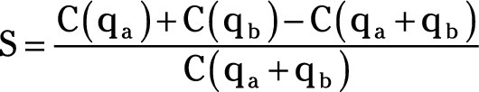
ECONOMIES OF SCOPE
Exist when the cost of producing two products jointly is less than the cost of producing each one individually
If S > 0, the firm is realizing economies of scope

Slide 17
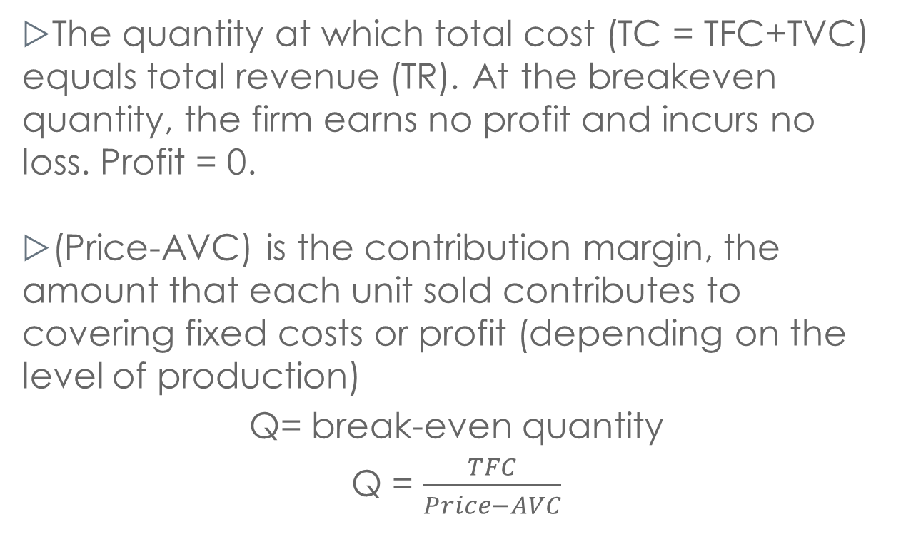
BREAKEVEN ANALYSIS
The quantity at which total cost (TC = TFC+TVC) equals total revenue (TR). At the breakeven quantity, the firm earns no profit and incurs no loss. Profit = 0.
(Price-AVC) is the contribution margin, the amount that each unit sold contributes to covering fixed costs or profit (depending on the level of production)
Q= break-even quantity
Q = $\frac{TFC}{Price−AVC}$

Slide 18
PROFIT CONTRIBUTION ANALYSIS
In order to determine what quantity (Q) will provide a certain level of profit, add a target profit amount to the total fixed costs in the numerator of your breakeven equation
Q = TFC+TARGET PROFIT
P-AVC

Slide 19
HOMEWORK SOLUTIONS

Slide 20
QUESTION 1
Costs for producing steel with different technologies:
coke, blast furnace, basic oxygen furnace, ingots, and finishing mills;
coke, blast furnace, basic oxygen furnace, continuous casting, and finishing mills;
steel scrap, electric arc furnace, continuous casting and finishing mills.
Estimated average cost per ton are as follows:
Cost Category | Technology 1 | Technology 2 | Technology 3
Process materials | $148.34 | $136.19 | $122.78
Energy | 21.15 | 15.98 | 41.58
Direct Labor | 83.43 | 75.09 | 67.43
Capital | 102.06 | 99.93 | 54.08
Other | 46.74 | 41.67 | 24.47
Total | 401.72 | 368.86 | 310.34

Slide 21
QUESTION 1
The MIT report concludes that “unless significant changes occur in other technologies, Technology 3 will dominate the domestic production.” Why?
At the same time, the report notes that the price of scrap (which is used in this route) “could increase as electric furnace production expands because of the increased demand.” Why is this relevant?

Slide 22
SOLUTION 1
Looking at Technology 3’s average cost per ton, it is the cheapest technology available
If the price of scrap, used in Technology 3, increases, then input costs for that technology will increase which leads to an increased average cost per ton which could potentially make producing steel with technology 3 more expensive on an average cost per ton basis than technology 1 or 2

Slide 23
QUESTION 1
c) The report also concludes that regardless of which of these technologies is used, cost per ton is about 25 to 30 % higher if wages are $26 per hour rather than $2 per hour. What does this imply about the competitiveness of U.S. steel producers relative to producers in other countries that pay wages far below U.S. levels?

Slide 24
SOLUTION 1
c) It suggests that U.S. steel companies may have a hard time competing with steel producers in low-wage countries due to the cost advantages (and therefore likely lower prices) that the low-wage countries have.

Slide 25
QUESTION 1
d) If these cost figures are long-run average costs, under what circumstances would they also equal long-run marginal costs?

Slide 26
SOLUTION 1
d) The long run average costs would equal long run marginal costs if the steel producers produce the level of output where long-run average cost is minimized.
In other words, if these are the minimum long-run average cost for each technology, then each average cost will equal the long-run marginal cost of each technology

Slide 27
QUESTION 2
There are three type of plants to make a particular electronic device.
Plant A is much more highly automated than plant B, which in turn is more highly automated than plant C.
For each type of plant average variable cost is constant so long as output is less than capacity, which is the maximum output of the plant.

Slide 28
The cost structure for each type of plant is as follows:
Average Variable Costs | Plant A | Plant B | Plant C
Labor | $1.10 | $2.40 | $3.70
Materials | 0.90 | 1.20 | 1.80
Other | 0.50 | 2.40 | 2.00
Total | $2.50 | $6.00 | $7.50
Total fixed costs | $300,000 | $75,000 | $25,000
Annual capacity | 200,000 | 100,000 | 50,000
Derive the average cost of producing 100,000; 200,000; 300,000; and 400,000 devices per year with plant A, B and C. If exceeding capacity, assume more than one plant is built. Plot the long run cost curve of producing different quantities of the electric devices.

Slide 29
SOLUTION 2
You would have to build 2 plants, increasing total fixed costs to $600K. $600K/ 300K units = $2.00 average fixed cost
PLANT | 100K units | 200K units | 300K units | 400K units
A | 3.00+2.50 = 5.50 | 1.50+2.50 = 4.00 | 2.00+2.50 = 4.50 | 1.50+2.50 = 4.00
B | 0.75+6.00 = 6.75 | 0.75+6.00 = 6.75 | 0.75+6.00 = 6.75 | 0.75+6.00 = 6.75
C | 0.5+7.50 = 8.00 | 0.5+7.50 = 8.00 | 0.5+7.50 = 8.00 | 0.5+7.50 = 8.00
D) I will graph the LRAC curves on the board during the tutorial

Slide 30
QUESTION 3
The Abner Corporation, a retail seller of television sets, wants to determine how many television sets it must sell to earn a profit of $10,000 per month. The price of each television set is $300, and the average cost is $100.
a)What is the required sales volume if the Abner Corporation's monthly fixed costs are $5,000 per month?

Slide 31
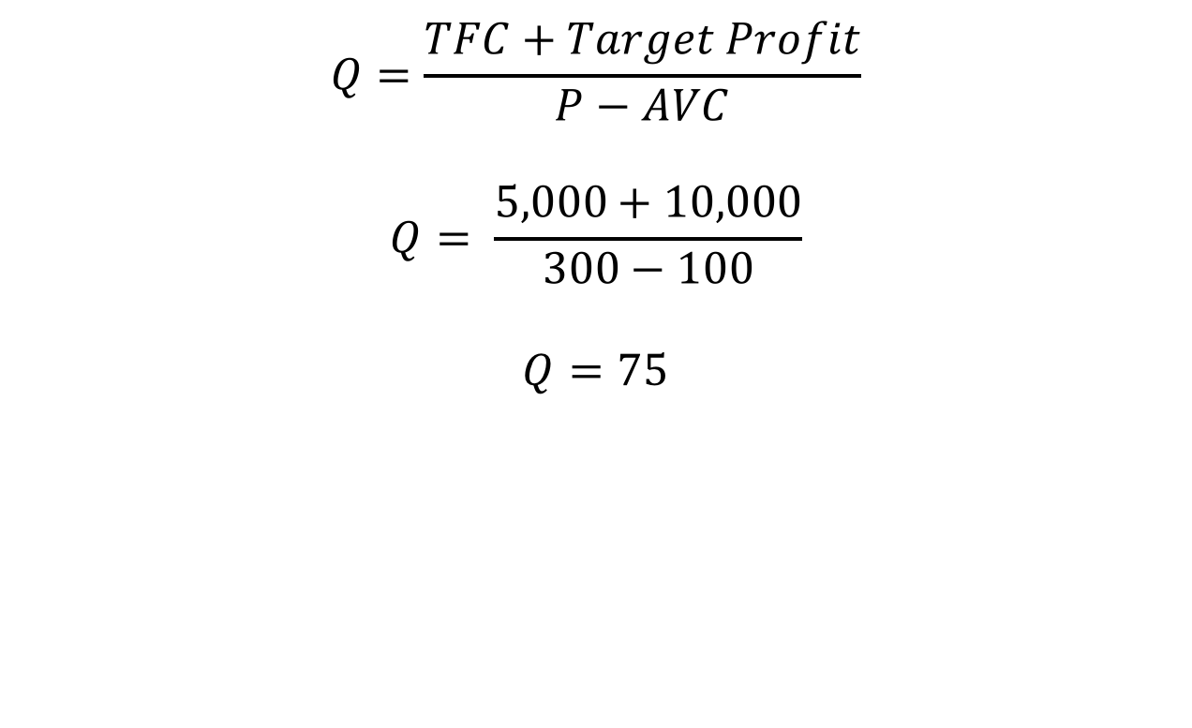
SOLUTION 3
$$Q=\frac{TFC+Target Profit}{P−AVC}$$
$$Q= \frac{5,000+10,000}{300−100}$$
$$Q=75$$

Slide 32
QUESTION 3
b) If the firm sells each television set at a price of $350 rather than $300, what is the required sales volume?
c) If the price is $350, and if the average variable cost is $85 rather than $100, what is the required sales volume?

Slide 33
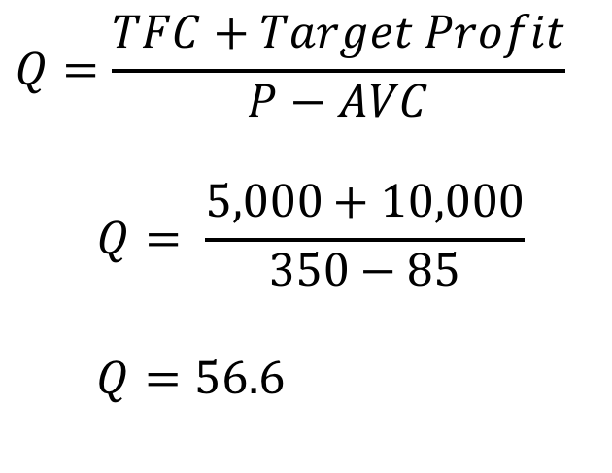
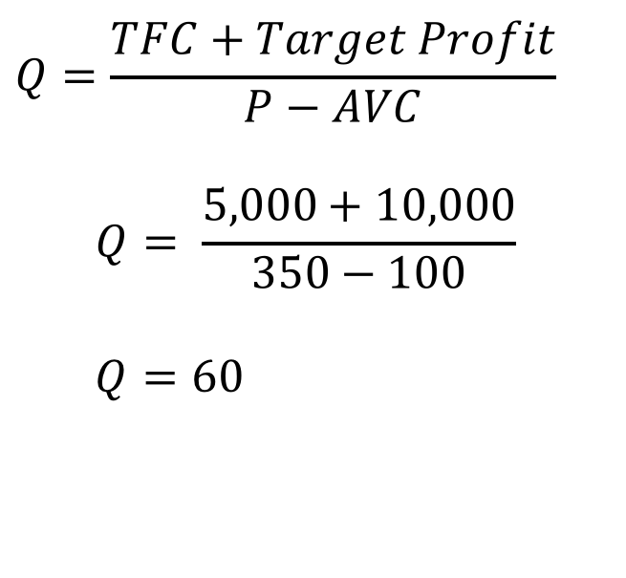
SOLUTION 3
$$Q=\frac{TFC+Target Profit}{P−AVC}$$
$$Q= \frac{5,000+10,000}{350−100}$$
$$Q=60$$
$$Q=\frac{TFC+Target Profit}{P−AVC}$$
$$Q= \frac{5,000+10,000}{350−85}$$
$$Q=56.6$$

Slide 34
QUESTION 4
According to a statistical study, the following relationship exists between an electric power plant’s fuel costs (C) and its eight-hour output as a percentage of capacity (Q):
C=16.68 + 0.125Q + 0.00439Q²
When Q increases from 50 to 51, what is the increase in the cost of fuel for this electric plant?

Slide 35
SOLUTION 4
a)
C(50)=16.68 + 0.125(50) + 0.00439(50²) = 33.905
C(51)=16.68 + 0.125(51) + 0.00439(51²) = 34.473
Increase of 0.56839

Slide 36
QUESTION 4
b) Of what use might the result of part (a) be to the plant’s manager?
c) Derive the marginal fuel cost curve for this plant, and indicate how it might be used by the plant’s managers.

Slide 37
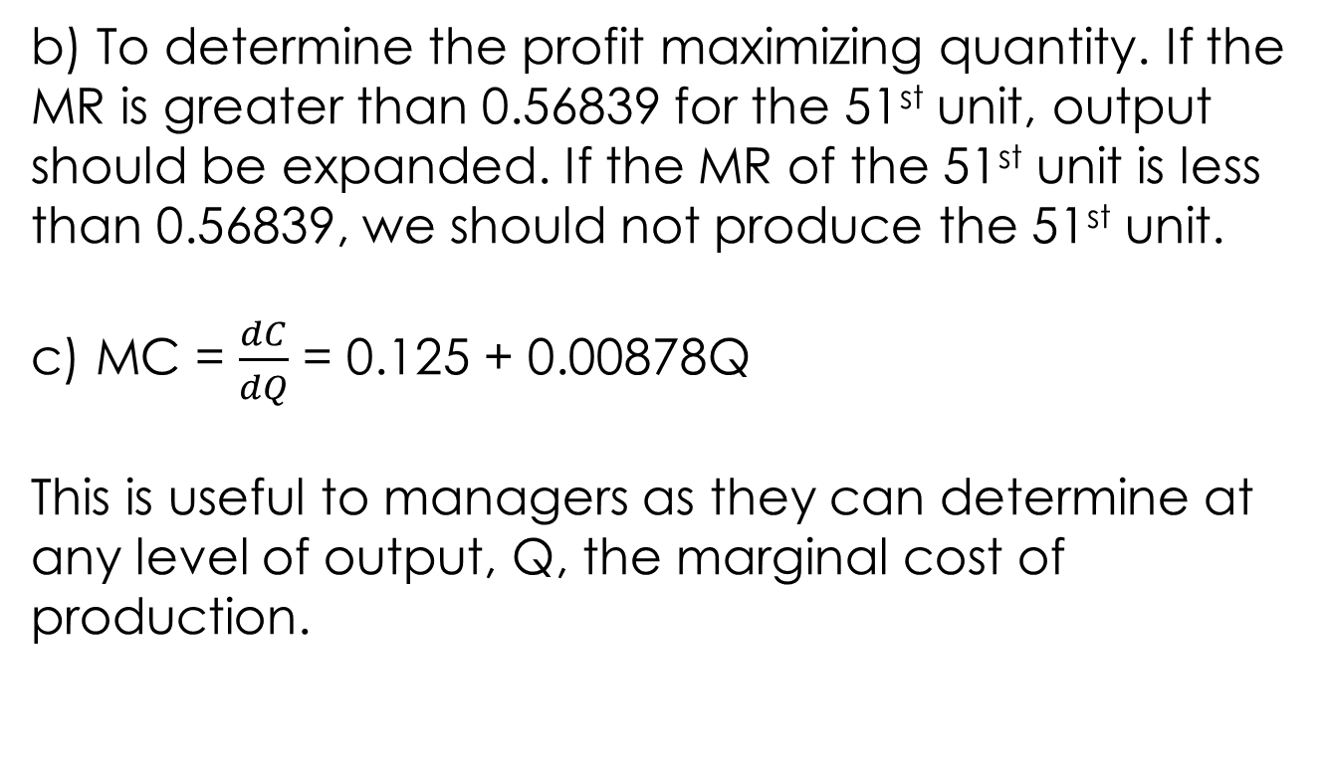
SOLUTION 4
b) To determine the profit maximizing quantity. If the MR is greater than 0.56839 for the 51st unit, output should be expanded. If the MR of the 51st unit is less than 0.56839, we should not produce the 51st unit.
c) MC = $\frac{dC}{dQ}$ = 0.125 + 0.00878Q
This is useful to managers as they can determine at any level of output, Q, the marginal cost of production.

Slide 38
QUESTION 6
The Deering Manufacturing Company’s short run average cost function in 2008 was
AC = 3+4Q
Where AC is firm’s average cost (in dollars per pound of the product), and Q is its output rate.
a)Obtain the equation for the firm’s short-run total cost function.

Slide 39
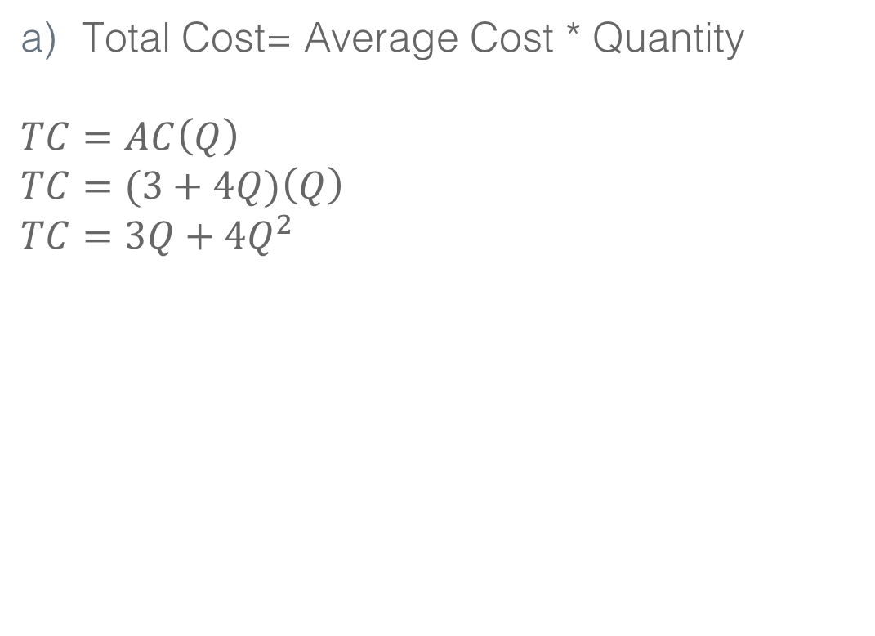
SOLUTION 6
Total Cost= Average Cost * Quantity
$$TC=AC\left(Q\right)$$
$$TC=(3+4Q)\left(Q\right)$$
$$TC=3Q+4Q^{2}$$

Slide 40
QUESTION 6
b) Does the firm have any fixed costs? Explain.
c) If the price of the Deering Company’s product (per pound) is $3, is the firm making profit or loss?
d) Derive an equation for the firm’s marginal cost function

Slide 41
SOLUTION 6
b) Since the firm’s total cost function is entirely dependent on Q, there are no fixed costs.
c) Recall, the average cost function is:
AC = 3 + 4Q
At any output greater than 0, we are making a loss since AC will be greater than $3 (the price at which the product is sold at).
d) TC = 3Q + 4Q²
MC = 3 + 8Q

Slide 42
QUESTION 9
The Dijon Company’s total variable cost function is
TVC = 50Q – 10Q² + Q³
What is the output level where marginal cost is a minimum?
B) What is the output level where average variable cost is a minimum?
C) What is the value of average variable cost and marginal cost at the output specified in the answer to part (b)?

Slide 43
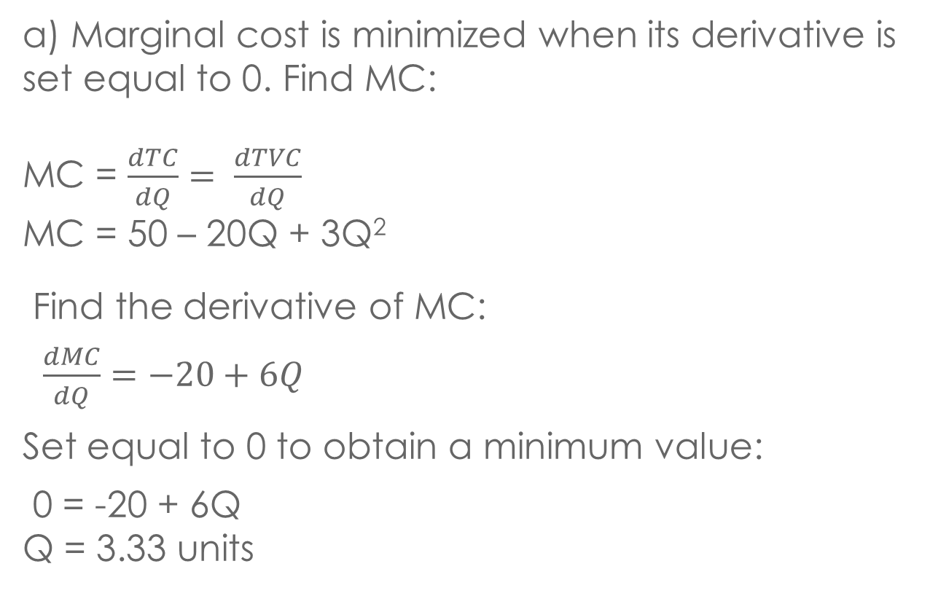
SOLUTION 9
a) Marginal cost is minimized when its derivative is set equal to 0. Find MC:
MC = $\frac{dTC}{dQ}= \frac{dTVC}{dQ}$
MC = 50 – 20Q + 3Q²
Find the derivative of MC:
$\frac{dMC}{dQ}=−20+6Q$
Set equal to 0 to obtain a minimum value:
0 = -20 + 6Q
Q = 3.33 units

Slide 44
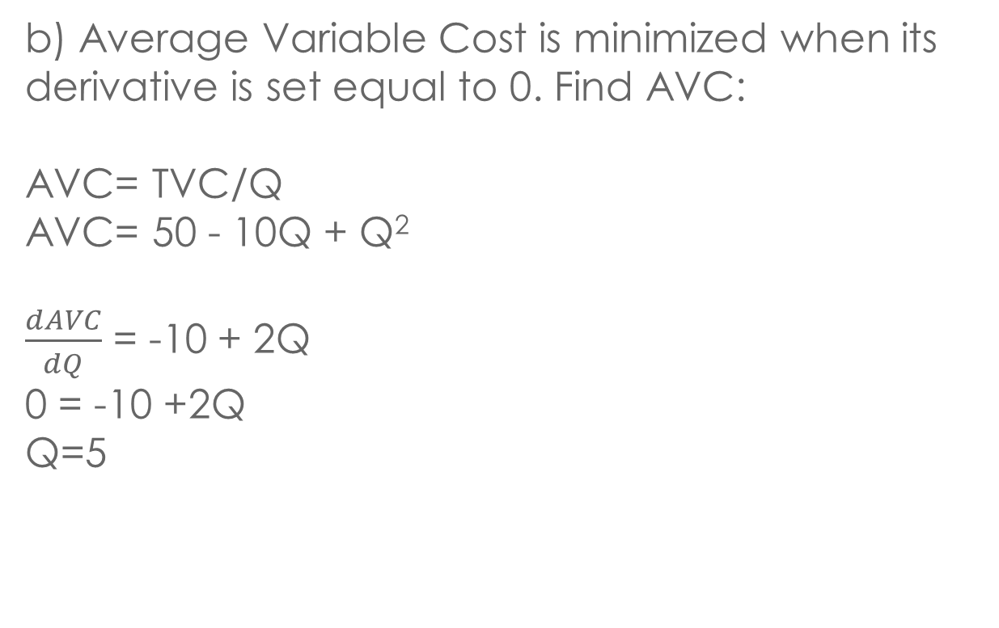
SOLUTION 9
b) Average Variable Cost is minimized when its derivative is set equal to 0. Find AVC:
AVC= TVC/Q
AVC= 50 - 10Q + Q²
$\frac{dAVC}{dQ}$ = -10 + 2Q
0 = -10 +2Q
Q=5

Slide 45
SOLUTION 9
C) When Q = 5,
AVC equals 50 – 10(5) + 5² = 25
MC equals 50 – 20(5) + 3(5²) = 25
Therefore, as expected MC = AVC at this output level

Slide 46
QUESTION 10
Berwyn Company has plenty excess manufacturing capacity to produce new products and the total fixed cost will be unaffected. Accountants decide that $300,000 of fixed charges will be absorbed by the new product. The variable cost per unit of making and selling the new product is $14, which is composed of the following:
Direct Labor | $8.20
Direct Material | 1.90
Other | 3.90
Total | $14.00

Slide 47
QUESTION 10
Should the Berwyn Company add the new product to its line if it can sell about 10,000 units of this product at the price of $25?

Slide 48
SOLUTION 10
a) The fixed cost were already SUNK COSTS.
Economist:
Profit = 10,000 * (25-14) = $110,000
YES
Accountant:
Profit = 10,000 * (25-14) – 300,000 = -$190,000
NO

Slide 49
QUESTION 10
b) Should it add the new product if it can sell about 10,000 units at a price of $20?
c) Should it add the new product if it can sell about 10,000 units at a price of $15?
d) What is the minimum price for the new product that will make it worth while for Berwyn to add the new product to its line?

Slide 50
SOLUTION 10
A quick way to tell if the price will make production worthwhile is by looking at the contribution margin. If the contribution margin is positive (ie: if P > AVC per unit), the product should be introduced:
b) Yes, since the P > Variable Cost per unit
c) Yes, since P > Variable Cost per unit
d) P > $14.00, as long as P>AVC, you will be covering your average variable cost per unit sold and some of your fixed costs. In other words, the minimum price is just above $14.00.

Slide 51
QUESTION 11
The Jolson Corporation produces 1,000 wood cabinets and 500 wood desks per year, the total cost being $30,000. If the firm produced 1,100 wood cabinets only, the cost would be $23,000. If the firm produced 500 wood desks only, the cost would be $11,000.
Calculate the degrees of the economies of scope
B) Why do economies of scope exist?

Slide 52
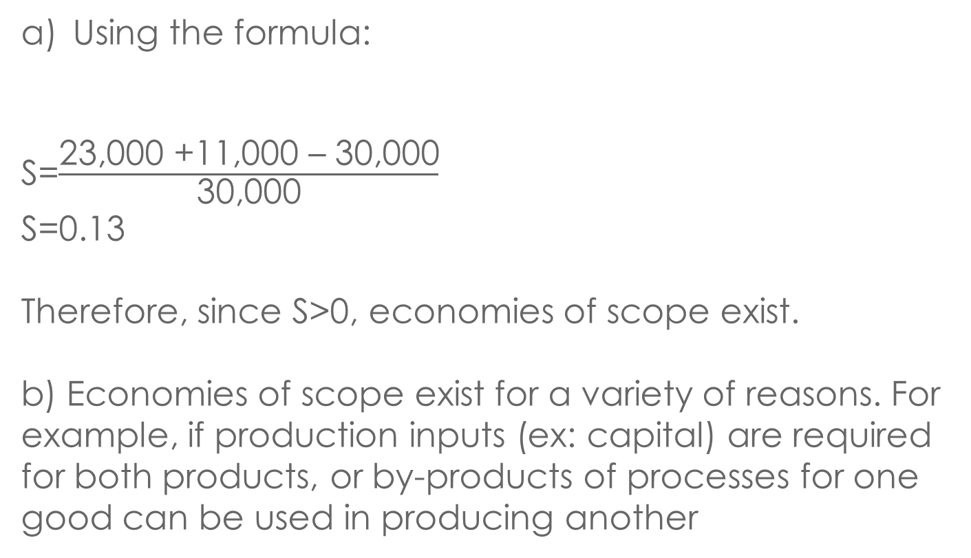
SOLUTION 11
Using the formula:
S=$\frac{\text{23,000 +11,000 }\text{–}\text{ 30,000}}{\text{30,000}}$
S=0.13
Therefore, since S>0, economies of scope exist.
b) Economies of scope exist for a variety of reasons. For example, if production inputs (ex: capital) are required for both products, or by-products of processes for one good can be used in producing another

Slide 53
QUESTION 12
Smith Company made and sold 10,000 metal tables last year. When output was between 5,000 and 10,000, its average variable cost was $24. In this output range, each table contributed 60 % of its revenue to fixed costs and profit.
What was the price per table?

Slide 54
SOLUTION 12
Revenues will either be allocated to covering costs (variable and fixed) or to profits
The question states that 60% of revenues went toward fixed costs and profits, therefore we assume that the remaining 40% of revenues was allocated to covering the variable costs
TVC=0.4(TR)
TVC=0.4(P)(Q)
TVC/Q=0.4(P)
AVC=0.4(P)
AVC/0.4=P
We know that Average Variable Cost = $24
$24/0.4=P
P = $60

Slide 55
QUESTION 12
b) If Smith Company increases its price by 10%, how many tables will it have to sell next year to obtain the same profit as last year?
b) First find last years profit:
π = $60(10,000 units) – TFC – $24(10,000 units)
π = $360,000 - TFC

Slide 56
SOLUTION 12
Next year:
P=1.1($60)=$66 → new price 10% higher than last year
π = TR – TFC – TVC
$360,000 – TFC = $66(# of tables) – TFC - $24(# of tables)
Notice that we do not need to know TFC as the TFC terms cancel out.
# of tables = ($360,000)/($66-$24)
# of tables = 8571.43 tables

Slide 57
QUESTION 12
c) If Smith Company Increases its price by 10%, and if AVC increases by 8% as a result of wage increase, how many tables will it have to sell next year to obtain the same profit as last year?

Slide 58
SOLUTION 12
Price is the same at $66
Average Variable Cost increases from $24 to $25.92 ($24(1.08) = $25.92)
Since π = $360,000 – TFC → π + TFC = $360,000
Q = TFC+TARGET PROFIT
P-AVC
Q= $360,000
$66-$25.92
Q=8,982.04 units

Slide 59
Q&A

